Slide 1
9. Securing a Web Application
Roy Chancellor

Slide 2
Overview
Simple web page that prevents unauthorized access with a username and password with Spring security acting as an intermediary to intercept requests to access the protected page
Download project from https://github.com/roychancellor/SpringDemos.git
Instructions for running are in Application.java
Once server is running, navigate to http://localhost:8080/home to see the home page, then click the link to see a special message. This will require a login with username = user and password = secret123

Slide 3
Project Structure
Application.java: contains main() which Spring finds and runs the SpringApplication.run method
MvcConfig.java: configures Spring controllers
WebSecurityConfig.java: defines the security parameters for the site, such as which HTTP requests are allowed and which require login
pom.xml: contains all of the Maven dependencies
Spring deploys the application in its own Tomcat server
Comments in the .java files explain how everything works

Slide 4
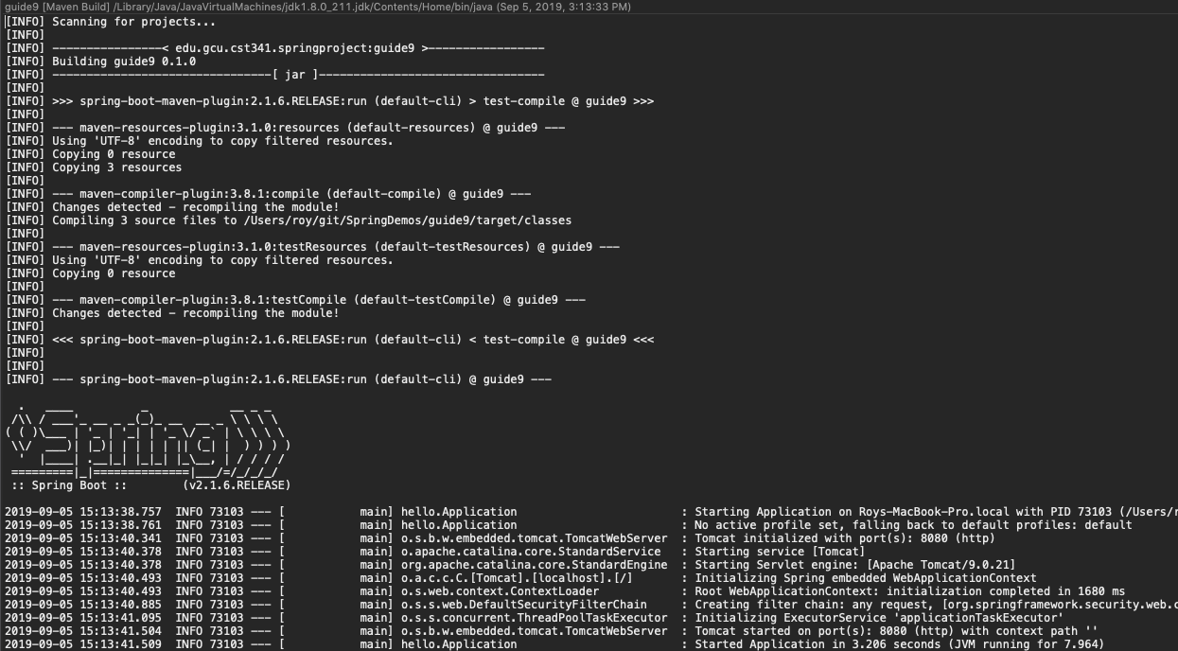
Screen Shots: Startup

Slide 5
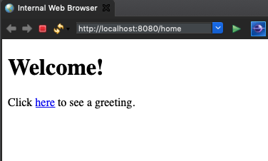
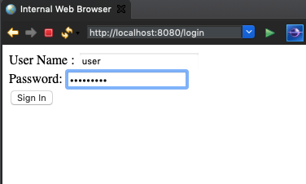
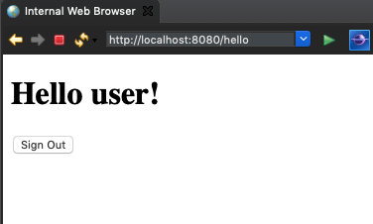
Screen Shots: Login and Secret Message

